Slide 1
DATA THIEVES
WeLive – how safe is your city?
Andrea Marino
Rickard Ramhöj

Slide 2
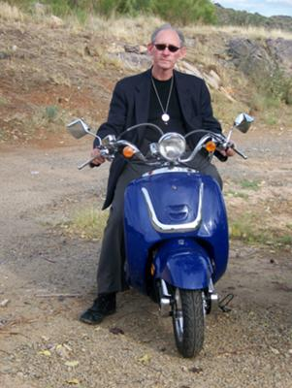
MISSION
Paulo has just bought a scooter. He’s looking forward to his new life as a mobile citizen. However, he has one problem. He doesn’t know whether he can leave his scooter out in the street, or whether he needs to pay for a garage.
Wouldn’t it be great if there was an app that told you how safe your area is?
Optimize your life choices.
Choose WeLive

Slide 3
GOAL
Our idea is to develop an app/website where you can choose the best city to live, today in Portugal, tomorrow all over the world, based on safety matters:
Numbers of crime committed divided by types
Numbers of car accidents
Crime Index perceived by locals
Safety Index perceived by locals
Notes:
(M) Your topic. Why did you choose it?

Slide 4
WORKPLAN
DATA ACQUISITION
DATASETS
API’S
WEB SCRAPING
Crime Numbers in Portugal per Cities (Dados.gov)
Traffic Flow data and Incidents (Here)
City Coordinates (Google Maps)
List of Cities with Population (Wikipedia)
Crime Index and Safety Index (Numbeo)

Slide 5
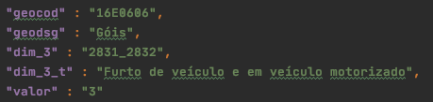


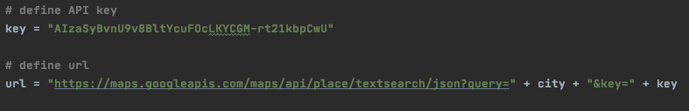
WORKPLAN
DATA ACQUISITION

Slide 6
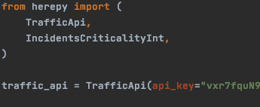


WORKPLAN
DATA ACQUISITION

Slide 7
WORKPLAN
COORDINATES
PERCEIVED CRIME
CITIES &
POPULATION
CRIME DATA
TRAFFIC DATA

Slide 8
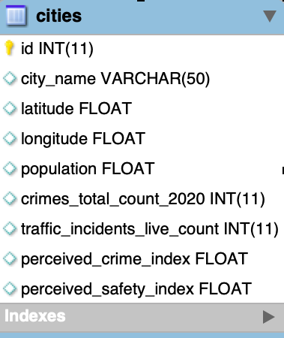
WORKPLAN
DATABASE
Send data to MySQLWorkbench
Fetch data to present to user

Slide 9
WORKPLAN
DATA CLEANING
Challenge:
Removing accents from city names to match with dataset with English names
Portimão ≠ Portimao
Setúbal ≠ Setubal
Lisboa ≠ Lisbon
Solution:

Slide 10
WORKPLAN
ANALYSIS
In order to present the data, it needs to be interpretable and relevant. We needed to
retrieve number of crimes per person for each city.
bin the crime data into 10 groups based on quantiles, in order to put individual crime rates into context [qcut]
assigning values to each quantile to make this data comparable
enable a comparison between cities based on perceived and actual crime rates.

Slide 11
WORKPLAN
REPORTING
The idea is to make it possible for the user to retrieve information about the safety of a city or to make a comparison between two cities.
As a first step, we have developed a command line tool where the user can
enter one city and get information about the crime rate of that city, or
enter two cities and get a comparison between those two cities

Slide 12
What’s Next
Including more parameters: air quality, pollution, weather phenomenal
Including more cities and different districts
Including more countries
Better user interface. Website.

Slide 13
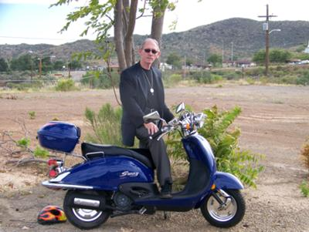
LET’S SEE HOW IT WORKS!

